Slide 1
MediTrack
</
/>
Sesha Sai Ramineni
M65147095

Slide 2
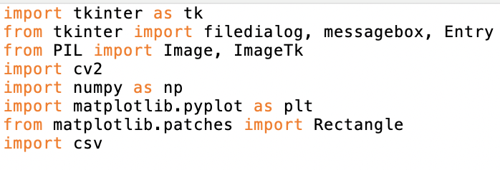
</
1.import tkinter as tk: Imports the Tkinter library for creating graphical user interfaces, and renames it to `tk` for shorthand usage.
2. from tkinter import filedialog, messagebox, Entry: Imports specific components from Tkinter:
- filedialog: Allows users to open file selection dialogs.
- messagebox: Provides methods to display message boxes.
- Entry: A widget for single-line text entry.
3. from PIL import Image, ImageTk: Imports classes from the Pillow library:
- Image: For creating and manipulating images.
- ImageTk: To display images using Tkinter.
4. import cv2: Imports the OpenCV library for processing and analyzing images with computer vision techniques.
5. import numpy as np: Imports the NumPy library, a fundamental package for scientific computing and handling large, multi-dimensional arrays and matrices.
6.import matplotlib.pyplot as plt: Imports the `pyplot` module from Matplotlib, used for creating static, interactive, and animated visualizations.
7. from matplotlib.patches import Rectangle: Imports the `Rectangle` class to draw rectangle shapes, useful for marking areas in visual data displays.
8. import csv: Imports the `csv` module to enable reading from and writing to CSV files, handling tabular data efficiently.

Slide 3
</Aim and Objectives
AIM:
Develop a desktop application that integrates image processing and graphical user interface capabilities to identify medications from images.
Enhance user understanding and management of medications by providing detailed information about detected drugs, including their usage, dosage, and side effects.
OBJECTIVES :
Utilize computer vision techniques to detect and identify tablet in images using OpenCV.
Manage a database of medications, loading and retrieving data from a CSV file.
Provide an interactive user experience through a GUI where users can manually input medication names or upload images to identify drugs.
Display relevant medication information clearly and effectively to users, assisting them in educational and management contexts.

Slide 4
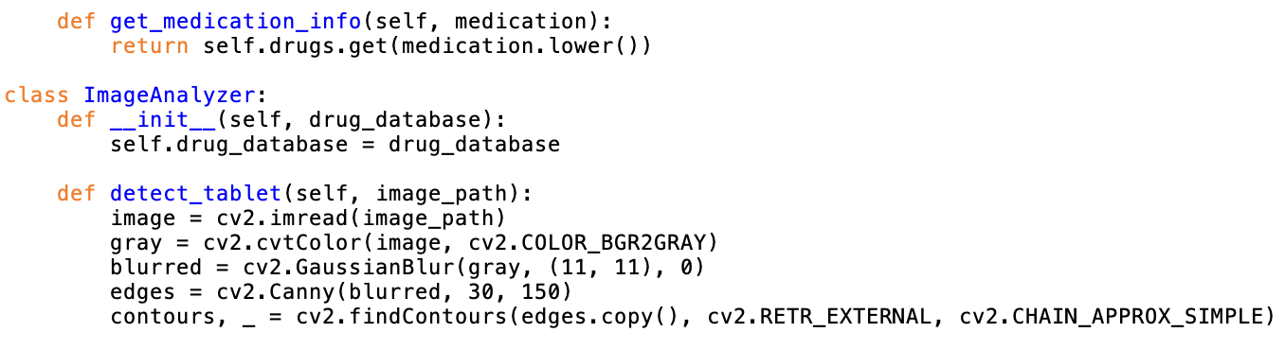
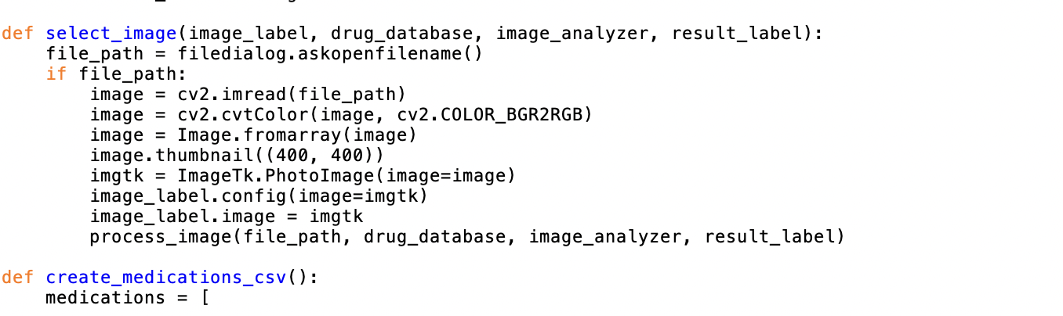
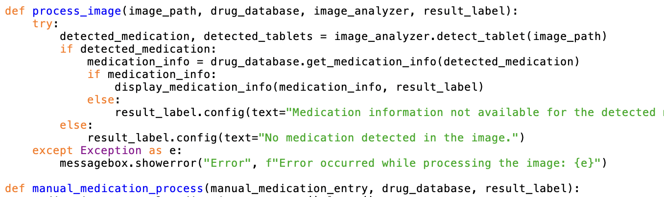
</
SOURCE CODE

Slide 5
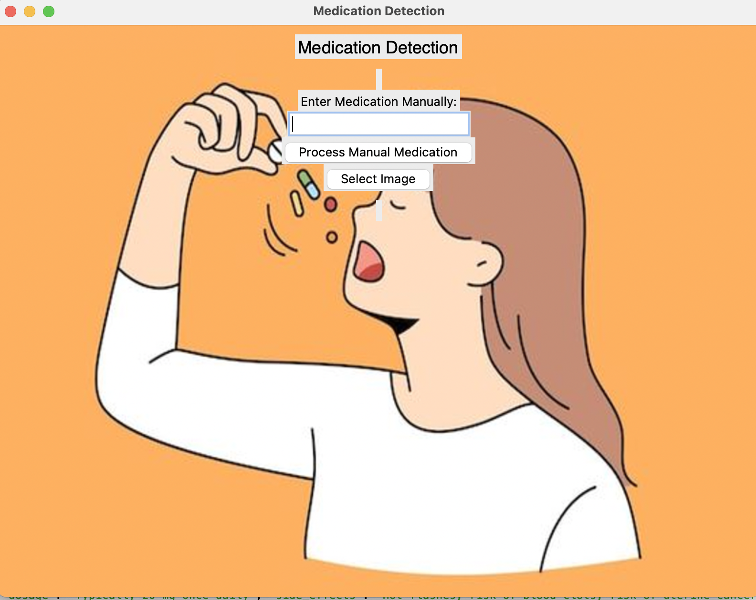
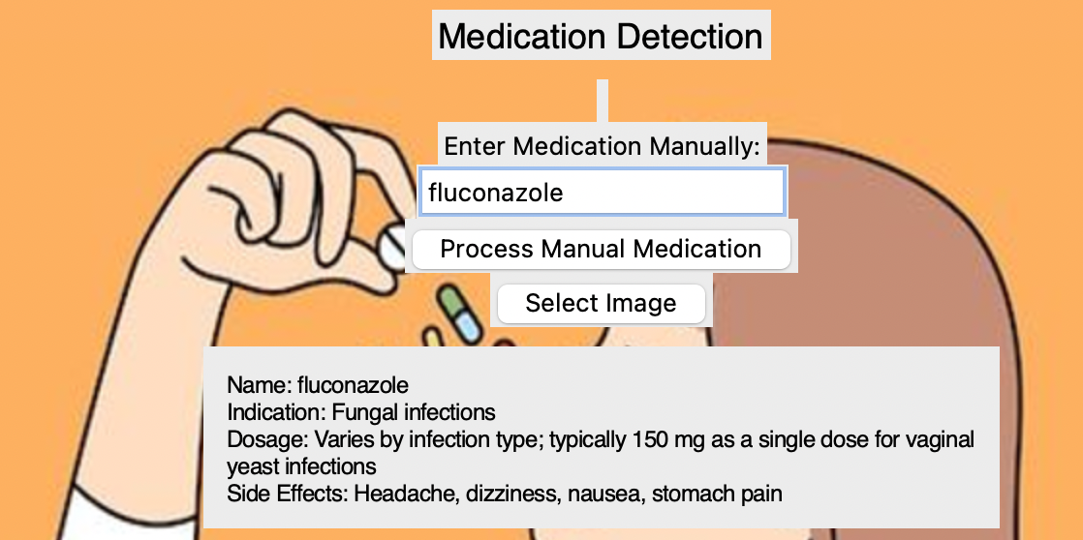
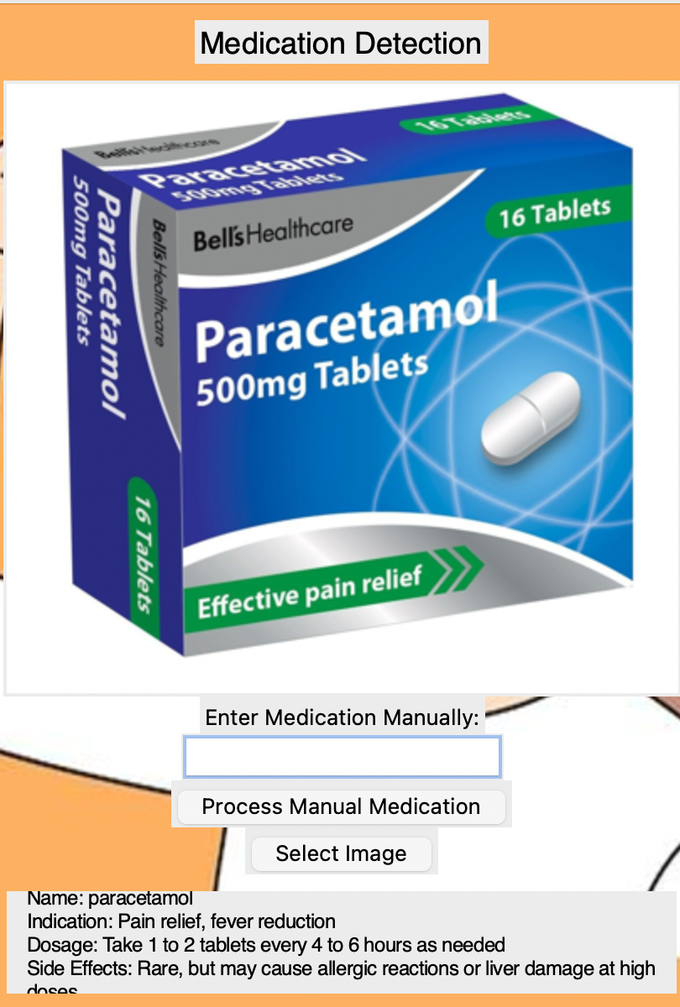
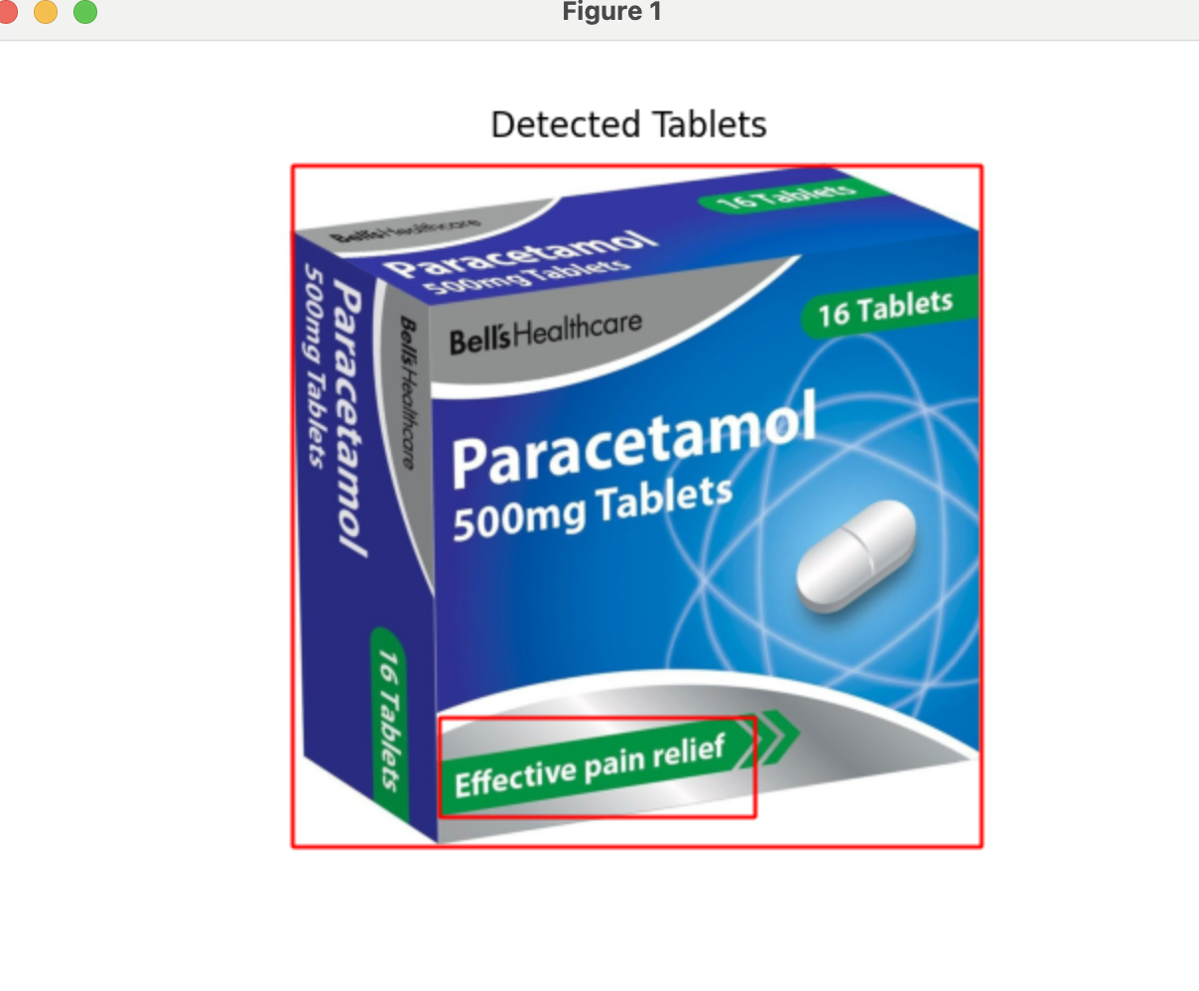
</
USER INTRFACE

Slide 6
</APPLICATIONS
Patient Assistance Programs
Medication Identification and Information System
Educational Tool for Pharmacology
Quality Control in Pharmaceutical Manufacturing
Inventory Management for Pharmacies
Drug Interaction Checker

Slide 7
</THANK YOU

